Slide 1
Cyber Warfare and National Security.

Slide 2
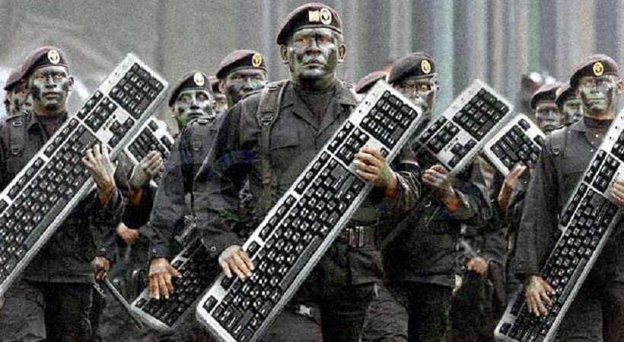
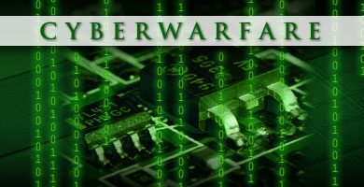


Cyber Warfare

Slide 3
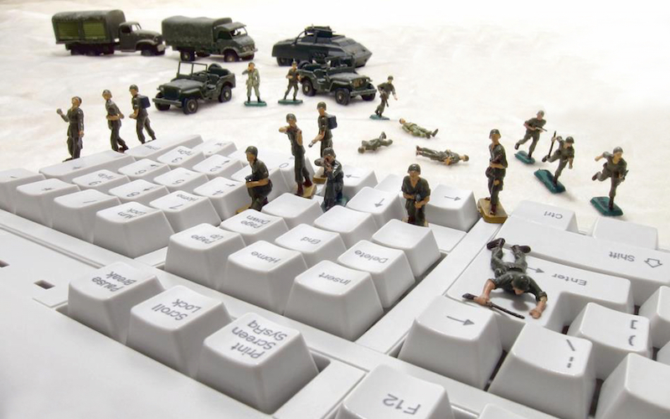
Cyber Security/Warfare
Cyber Warfare is Internet-based conflict involving politically motivated attacks on information and information systems.
Cyber warfare involves the actions by a nation-state or international organization to attack and attempt to damage another nation's computers or information networks through, for example, computer viruses or denial-of-service attacks.

Slide 4
Cyber warfare
Cyber warfare attacks can
Disable official websites and networks
Disrupt or disable essential services
Steal or alter classified data
cripple financial systems -- among many other possibilities.

Slide 5
NEW Wars New Tools
It has become abundantly clear that the next great frontier of threats for nation states across the globe exists in the cyber realm. From government and military to the private sector, various nations, industries, groups and agencies have been the targets (and in some cases the ones who carry out) cyber attacks.

Slide 6
Impacts of Cyber Warfare.
In recent years, the number of cyber-attacks that hit private companies and government entities has rapidly increased. The damage caused by sabotage and by the theft of intellectual property amounts to several billion dollars each year.
In the majority of cases victims of attacks can only find losses relating to the raids of the opponents. Law enforcement and private companies are publicly discussing the possibility to define new strategies to defend their assets from the attacks.

Slide 7
Impacts of Cyber Warfare.
It is getting complicated as there is no longer any realistic expectation of a single solution or even a single family of solutions that can provide a comprehensive approach to the problem space.
It is personal as cyber security issues now impact every individual who uses a computer. It is no longer science fiction – millions of people worldwide are the victims of cyber-crimes.
It is a business as almost every business today is dependent on information and vulnerable to one or more types of cyber-attacks -

Slide 8
approaches to cyber security
Two Most Common Approaches
Defensive
Offensive
Defensive: Currently Most Countries have Adopted Defensive approach but fact is the security community is aware of the growth of cyber threats and the current defensive approach is showing its limit to tone down the menace from cyberspace. The cyber threats are dynamic and their attacks are difficult to predict.

Slide 9

Defensive Approach
The success of recent attacks conducted by cybercriminals and state-sponsored hackers led security experts to believe that a defensive approach waiting for the attackers it totally inappropriate.

Slide 10
Offensive: (Proactive)
In many cases victims discovers the attacks many years, after they occurred when it is too late to apply mitigation measures and the consequences are dramatic.

Slide 11
Next Cold war
It is war; in fact it is already becoming the next Cold war. Cyber operations are also becoming increasingly integrated into active conflicts.

Slide 12
Cyber Active Countries:
Major powers increasingly rely on digital networks for critical services. The US turns to a cyber-arms race, quite similar to the nuclear arms race, is building up stockpiles of software and malware to attack computer systems of rival states. China, Iran, North Korea, and Russia have demonstrated an ability to conduct robust cyber activity.

Slide 13
Pakistan and Cyber Warfare:
The Internet security company McAfee stated in its 2007 annual report that approximately 120 countries have been developing ways to use the internet as a weapon and target financial markets, government computer systems and utilities.
Indian hackers often hacked and penetrated the government websites of Pakistan and left derogatory messages. In “Operation Hangover” against Pakistan, cyber analysts in Norway claimed that hackers based in India have been targeting government and military agencies in Pakistan since 2010 and extracting information of national security interest to India.

Slide 14
Indian Cyber Intervention
“Black Dragon Indian Hackers Online Squad” defaced official websites of Pakistan People’s Party (PPP), apparently annoyed by PPP Chairman Bilawal Bhutto-Zardari’s remarks about Kashmir

Slide 15
Pakistan’s digital infrastructure:
Pakistan does have cyber-crime law but unfortunately it is not being implemented effectively. There is also a lack of awareness about the law

Slide 16
Pakistan’s digital infrastructure:
More over Laws regulating cyber-crimes in Pakistan have never been impressive.
People of Pakistan hardly have any idea about the existence of such laws. There had been an “Electronic Transactions Ordinance 2002”, which mostly dealt with banking. But the first ever pertinent law, i.e. “Pakistan’s Cyber Crime Bill 2007”, which focuses on electronic crimes
i.e. cyber terrorism, criminal access, electronic system fraud, electronic forgery, misuse of encryption etc has been there. But if one sees its implementation, the statistics are poor.

Slide 17
Prevention of Electronic Crimes Bill 2015
The current government’s first ever comprehensive law, i.e. “Prevention of Electronic Crimes Bill 2015”, which is struggling and facing lot of criticism on its content.
As per critics, there are many ambiguities in definitions of certain sections/clauses.
It focuses more on moral aspects of internet use than cyber-crime itself.
The Section 31of the proposed bill says that the govt could block access to any website “in the interest of the glory of Islam or the integrity, security or defense of Pakistan or any part thereof, friendly relations with foreign states, public order, decency or morality….”

Slide 18
Confusion
Now the question arises who is to decide what undermines the integrity of Pakistan, or its relations with other states? Who exactly are the “friendly foreign states”, and where would countries with which Pakistan has fluctuating ties such as the United States (US) be placed?

Slide 19
Recommendations:
Pakistan government should also introduce such laws that could not only address cyber-crimes but cyber terrorism. Because, in modern terrorist environment, terrorists/non-state actors make full use of internet for fund raising, propaganda, threats and recruitment, etc. The new law must be crystal clear in its definitions so that it could not be used for or against through different interpretations of the sections/clauses

Slide 20
Recommendations:
There is need of holding workshops and seminars to create awareness among the masses.
There must be severe actions against criminals.
Anti-virus and anti-spam soft wares should be installed.
Vulnerability assessment of famous Apps for smart phone may be done.
“National cyber security awareness day” be organised to make people aware of this.

Slide 21
Recommendations:
With hyperactive social media in Pakistan, it is critical to study the potential and limitations of the internet.
It is crucial academics to try and better understand the landscape of internet in Pakistan.
Cyber-attacks and defiance should eventually be part of Pakistan’s military strategy.
Cyber defense, elevation of the role of the private sector, and support research need improvement.
“Bureau of Internet and Cyberspace Affairs” should be established in the Ministry of Information Technology.

Slide 22
Recommendations:
Emergency mechanisms for dealing with internet attacks be developed. Formation of a Cyber Working Group (CWG) between Pakistan and India should be discussed with India to make it part of the “Composite Dialogue” to have regular discussions on the subject to avert the possibility of resorting to cyber warfare

Slide 23
References:
http://www.ipripak.org/cyber-securitywarfare-and-pakistan/#sthash.8xB7b1zJ.CfK8dg0G.dpuf
http://www.slideshare.net/ideaflashed/cyberwarfare
mysteriousuniverse.org/2015/05/cyber-security-the-best-defense-is-a-good-offense
http://www.ipripak.org/cyber-securitywarfare-and-pakistan/#sthash.8xB7b1zJ.CfK8dg0G.dpbs

Slide 24
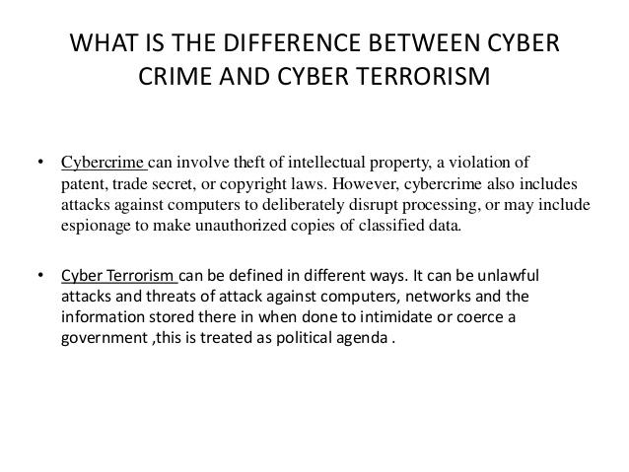

Slide 25
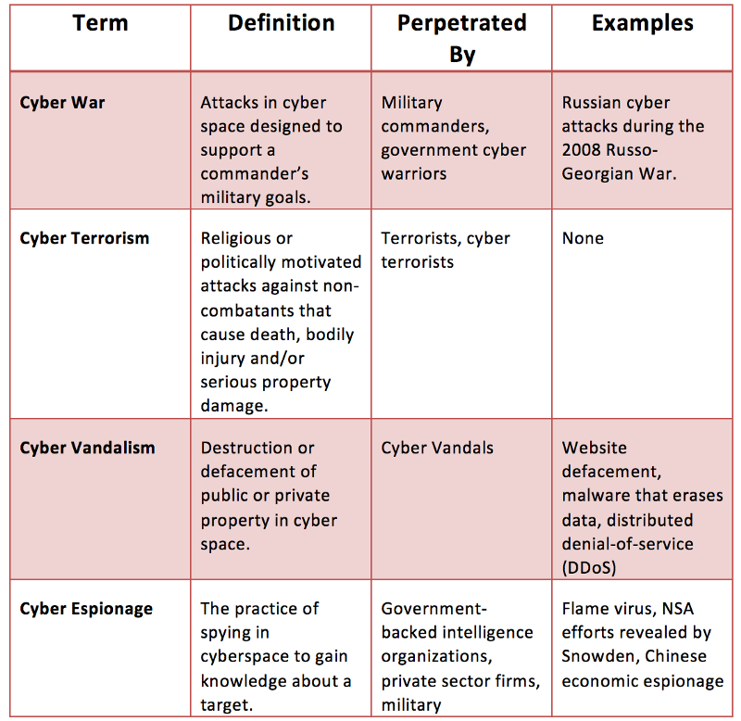

Slide 26

4.4 million dollars

